Slide 1
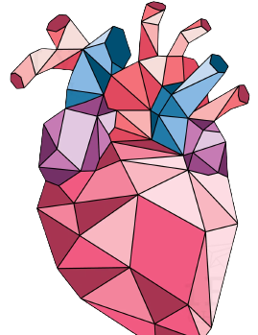
CardioGuardian: A Novel ECG-based Diagnostic Pathway for Early Detection of Contributory Disorders to SCA
Evan Xiang
Shady Side Academy
10th Grade

Slide 2
Thousands of familes are left to deal with the trauma and financial burden that develops from each instance
Sudden Cardiac Arrest is a Major Issue in Youth
60 million K-12 students participate in competitive athletics
3,000+ youth athletes are afflicted per year²
90% from undiagnosed conditions
1 in 300 have an undiagnosed disorder that may lead to SCA¹
Notes:
SCA is a massive issue in youth athletes. Over 60 million k-12 students in the US participate in youth competitive athletics each year, 1 in 300 will have a undiagnosed disorder that could lead to an instance of SCA or sudden cardiac arrest. Over 3000 youth athletes are afflicted with SCA each year with over 90% due to undiagnosed conditions. Thousands of families are left to deal with the resulting emotional and financial burden from each and every instance of SCA

Slide 3
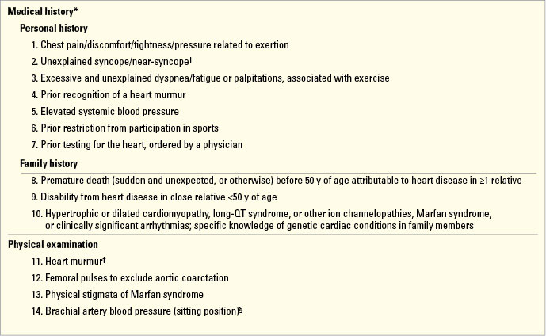
There must be a better method
Current Methods of Screening are Ineffective
The 14-point screening system by the American Heart Association³ is ineffective
Never proven to be clinically effective in any controlled study⁴
Poor sensitivity and specificity of 19.0% and 68.0%^{5,8}
Flawed concept: 80% of SCA victims have SCA as the 1st symptom⁶
Adapted from: https://urgentcareassociation.org/shop/clinical/performance-of-the-aha-14-point-evaulation-vs-electrocardiography/
Notes:
The current method of pre-athletic screening in the US is the AHA suggested 14-point screening system. However, this method has never been clinically validated in any controlled study and has repeatedly been shown to have low sensitivity and specificity of 19% and 68% respectively. This because the questionnaire portion of the 14 point method, relies on faulty scientific methodology. Over 80% of cases of SCA have SCA as the first symptom of their underlying disorder, thus invalidating history-focused screening systems. There must be a better method.

Slide 4
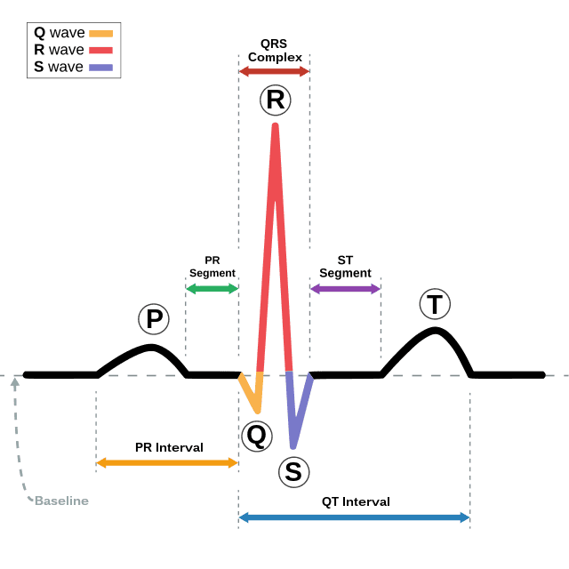
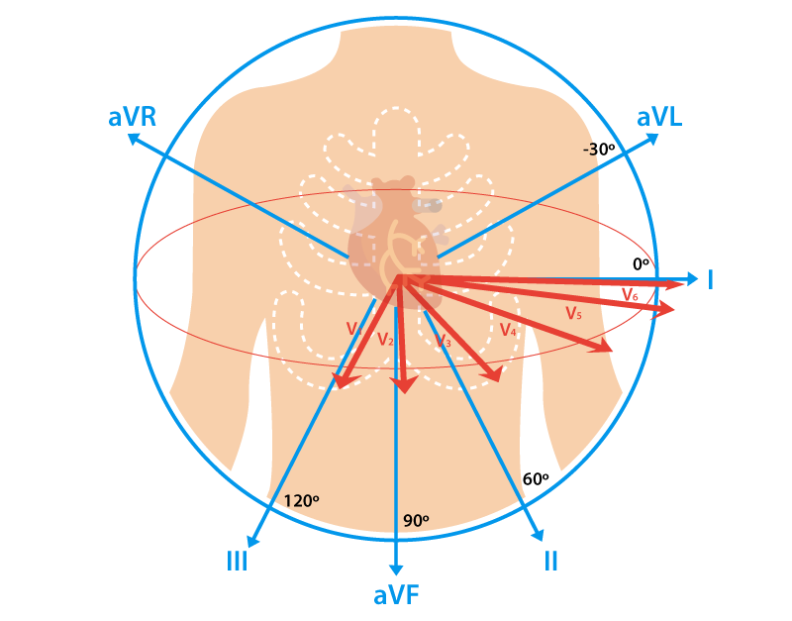
12-Lead ECG Screening is the Gold Standard
Electrocardiography (ECG) is a graphical representation of the heart’s electrical activity over time
The Lausanne Recommendations by the IOC utilize 12-lead ECG as a gold standard⁵
Corrado demonstrated the effectiveness of ECG mass screening in Venado, Italy⁷
Sensitivity and specificity are higher at 87.5% and 91% respectively⁸
Adapted from: Wang, Fei & Syeda-Mahmood, Tanveer & Beymer, David. (2009). Information Extraction from Multimodal ECG Documents. Proceedings of the International Conference on Document Analysis and Recognition, ICDAR. 381-385. 10.1109/ICDAR.2009.189.
So why isn’t this used in the USA?
Adapted from: https://www.cablesandsensors.com/pages/12-lead-ecg-placement-guide-with-illustrations
Notes:
12 lead ECG is the gold standard for pre-participation screening. ECG or electrocardiography is a graphical representation of the heart over time. Essentially ECG looks at the heart from two axis along different locations, making it comprehensive and good for diagnosis. The Lausanne Recommendations put forward by the International Olympic Committee and the European Society of Cardiology, suggests 12 lead ECG screening as the GOLD standard for ALL athletes in pre-participation screening. Corrado demonstrated effectiveness of this method of ECG screening in the Venado Region of Italy, where the implementation of a 12 lead ECG screening system decreased the rates of SCA by nearly 89%. This is again confirmed by 12 lead ECGs vastly higher sensitivity and specificity of 87.5% and 91% respectively. So why don’t we use this in the USA?

Slide 5
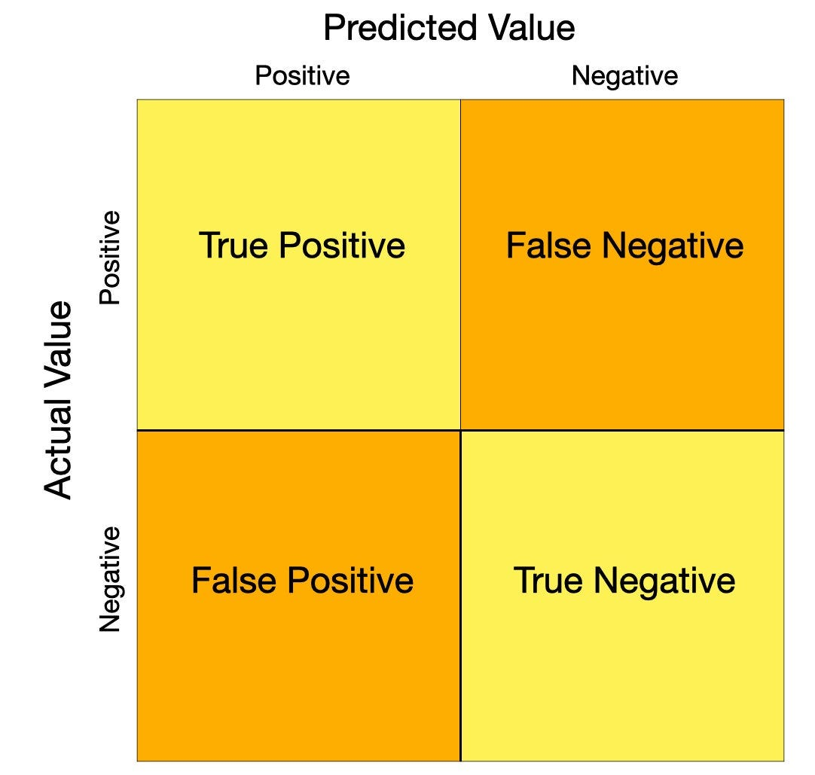
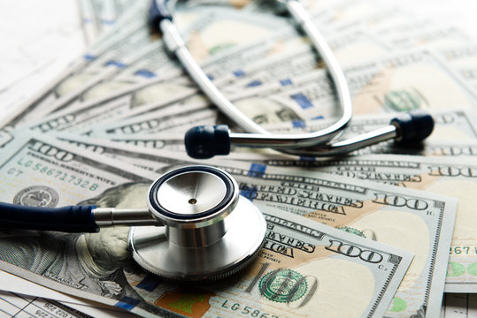
Cost-Effectiveness of ECGs is Low
ECG screening isn’t recommended by the American College of Cardiology based on economic and numerical concerns⁹
False positive rate (FPR) relatively high for mass screening (9%)⁷
Critical threshold is 4% FPR for economic viability in USA¹⁰
ECGs that need for physician interpretation are unfeasible, as this requires too many resource
Adapted from: https://medium.com/@Sanskriti.Singh/an-emphasis-on-the-minimization-of-false-negatives-false-positives-in-binary-classification-9c22f3f9f73
Our protocol solves these issues
Taken from: https://stock.adobe.com/search?k=healthcare+money
Notes:
The cost effectiveness of ECG screening is relatively low. ECG screening isn’t recommended by the American College of Cardiology solely due to economic and numerical concerns. Though a FPR of 9% may be fine for personal screening. it is unacceptable for a scenario which involves the screening of over 60 million people, as this would cause unacceptable downstream costs. The critical threshold for ECG viability in the US is around 4%. Secondly, ECGs also need countless physicians to confirm machine embedded classification systems. Our protocol solves these issues.

Slide 6
Hypothesis
The use of artificial intelligence in a novel screening protocol may decrease the false positive rate (FPR) of ECG screening and increase economic viability.
Goals
Reduce device cost by 75%
Accurate classification with high sensitivity and specificity of 96% each

Slide 7
Comprehensive Screening System
Sequential 4 lead ECG for System Input
Data Preprocessing
Upscaling Algorithm
Transformer Encoding
Diseased
Transformer Encoding
Transformer Encoding
Classification via Support Vector Machine
Transformer Encoding
Transformer Encoding
Autoencoders for Dimensionality Reduction
Non-Diseased
Notes:
Starting with a Sequential 4 lead ECG for System input, we then moved into data pre-processing to process this data into machine interpretable signals. This standardized data was then inputted into the upscaling algorithm which used cubic splines to convert from 4 leads to 12 leads. Finally, we utilized transformer feature extraction and autoencoder dimensionality reduction to classify using features into binary classification as Diseased or Non-Diseased.

Slide 8
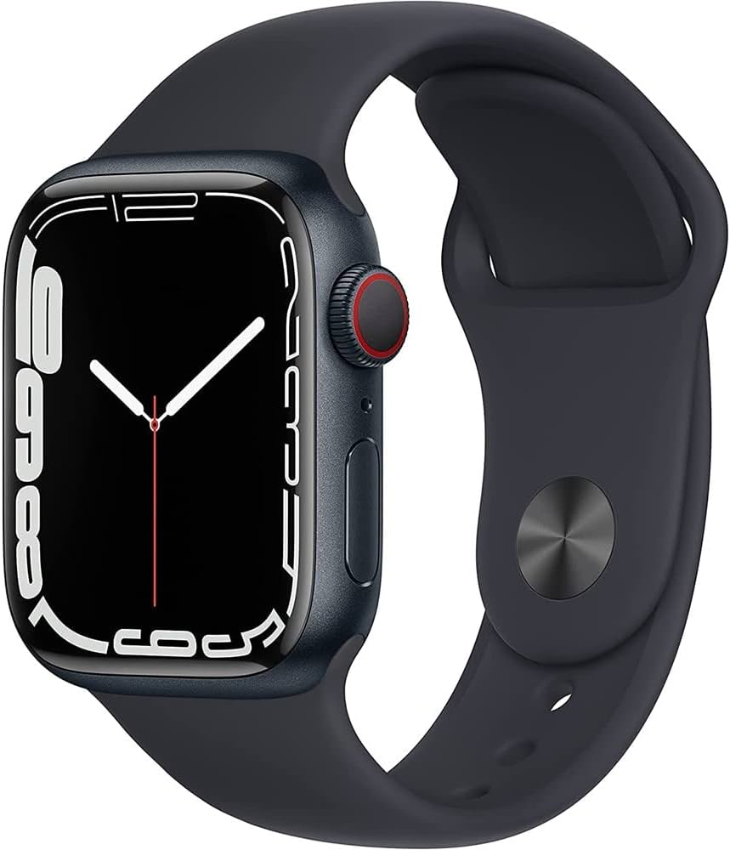
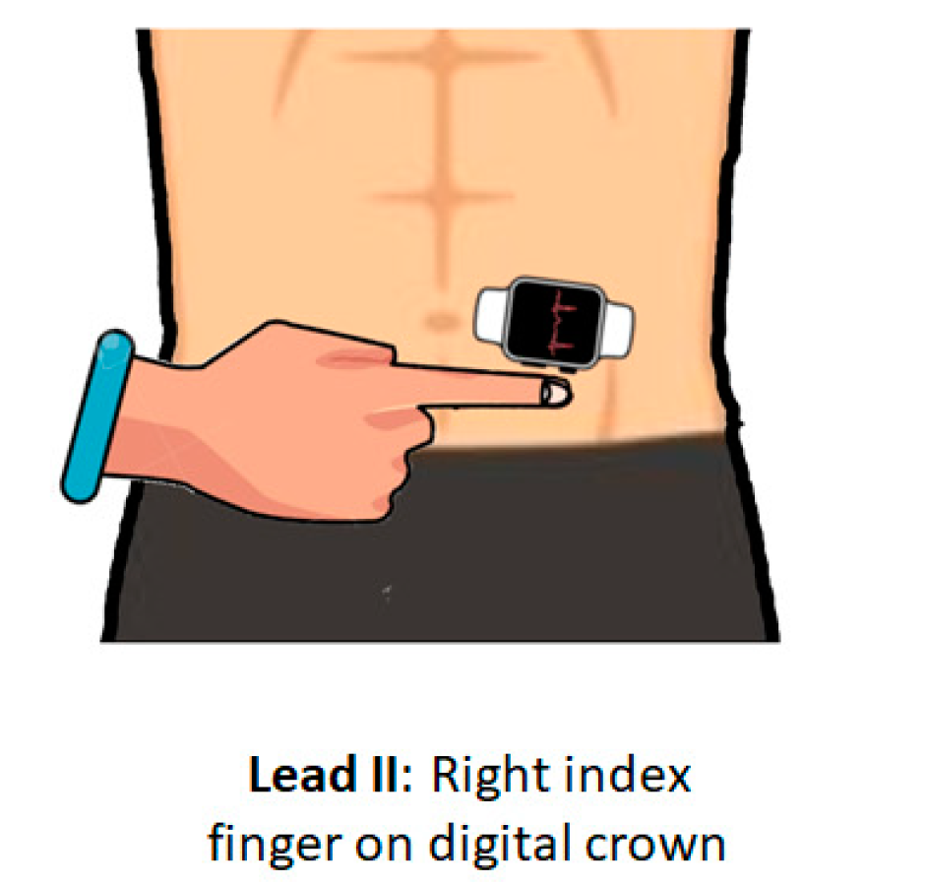
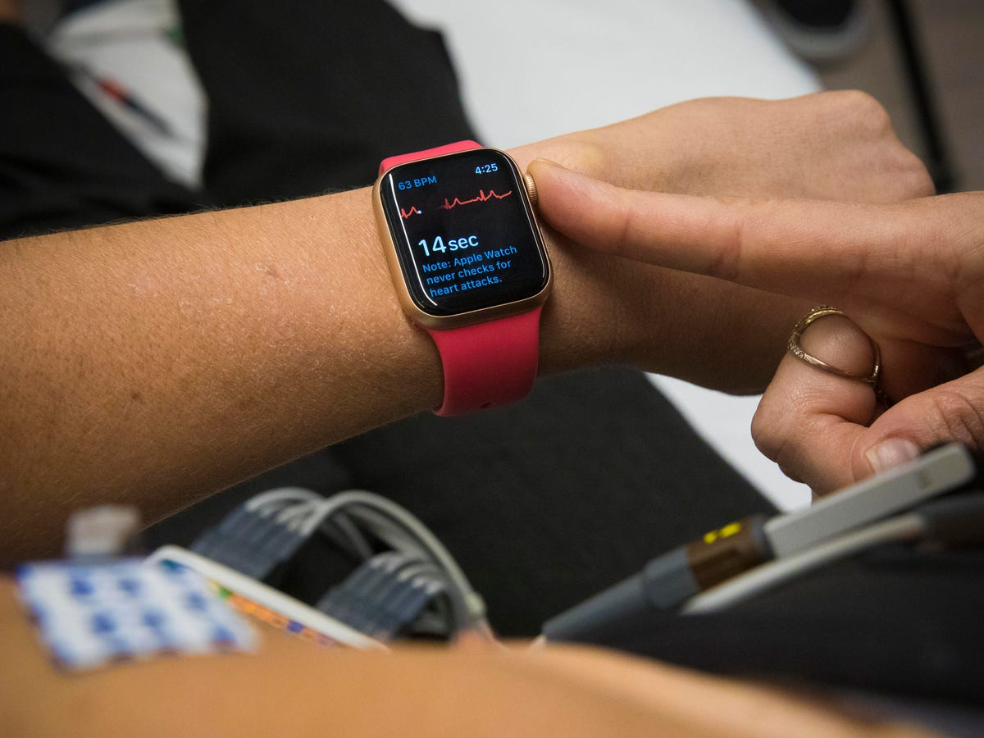
System Input
System input device
Apple Watch Series 7 (Cost: $198)
Ability to take a 1 lead ECG: 16-bit resolution at 250 Hz sampling rate, similar to clinical device
Positioned at different locations in accordance with the upscaling leads
ECGs were performed
sequentially instead of
simultaneously
Apply Dynamic Time Warping and Phase Correction to correct and align data
Adapted from: https://www.apple.com/newsroom/2021/09/apple-reveals-apple-watch-series-7-featuring-the-largest-most-advanced-display/
Adapted from: https://www.cnet.com/health/apple-watch-ecg-app-what-cardiologists-want-you-to-know/
Notes:
For system input we utilized an apple watch series 7, with a current secondhand market value of about 198 dollars. The Apple Watch has the ability to take a 1 lead ECG at 16 bit resolution at 250 Hz, similar to many commercial level ECGs. We positioned the watch in different places around the body in order to derive our 4 leads needed for upscaling. ECGs in this case were performed sequentially insead of simultaneously to mitigate hardware cost-concerns, however we can solve the issue of misalignment of ECG signals by applying dynamic time warping and phase correction to correct and align the data to improve the accuracy of our ECG

Slide 9
Comprehensive Screening System
Sequential ECG for System Input
Data Preprocessing
Upscaling Algorithm
Transformer Encoding
Diseased
Transformer Encoding
Transformer Encoding
Classification via Support Vector Machine
Transformer Encoding
Transformer Encoding
Autoencoders for Dimensionality Reduction
Wildtype

Slide 10
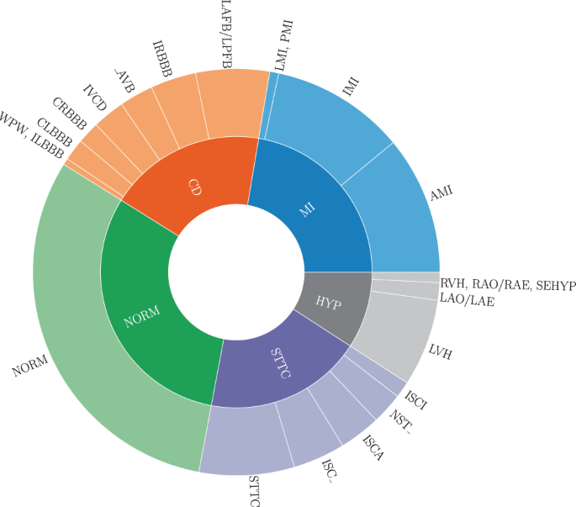
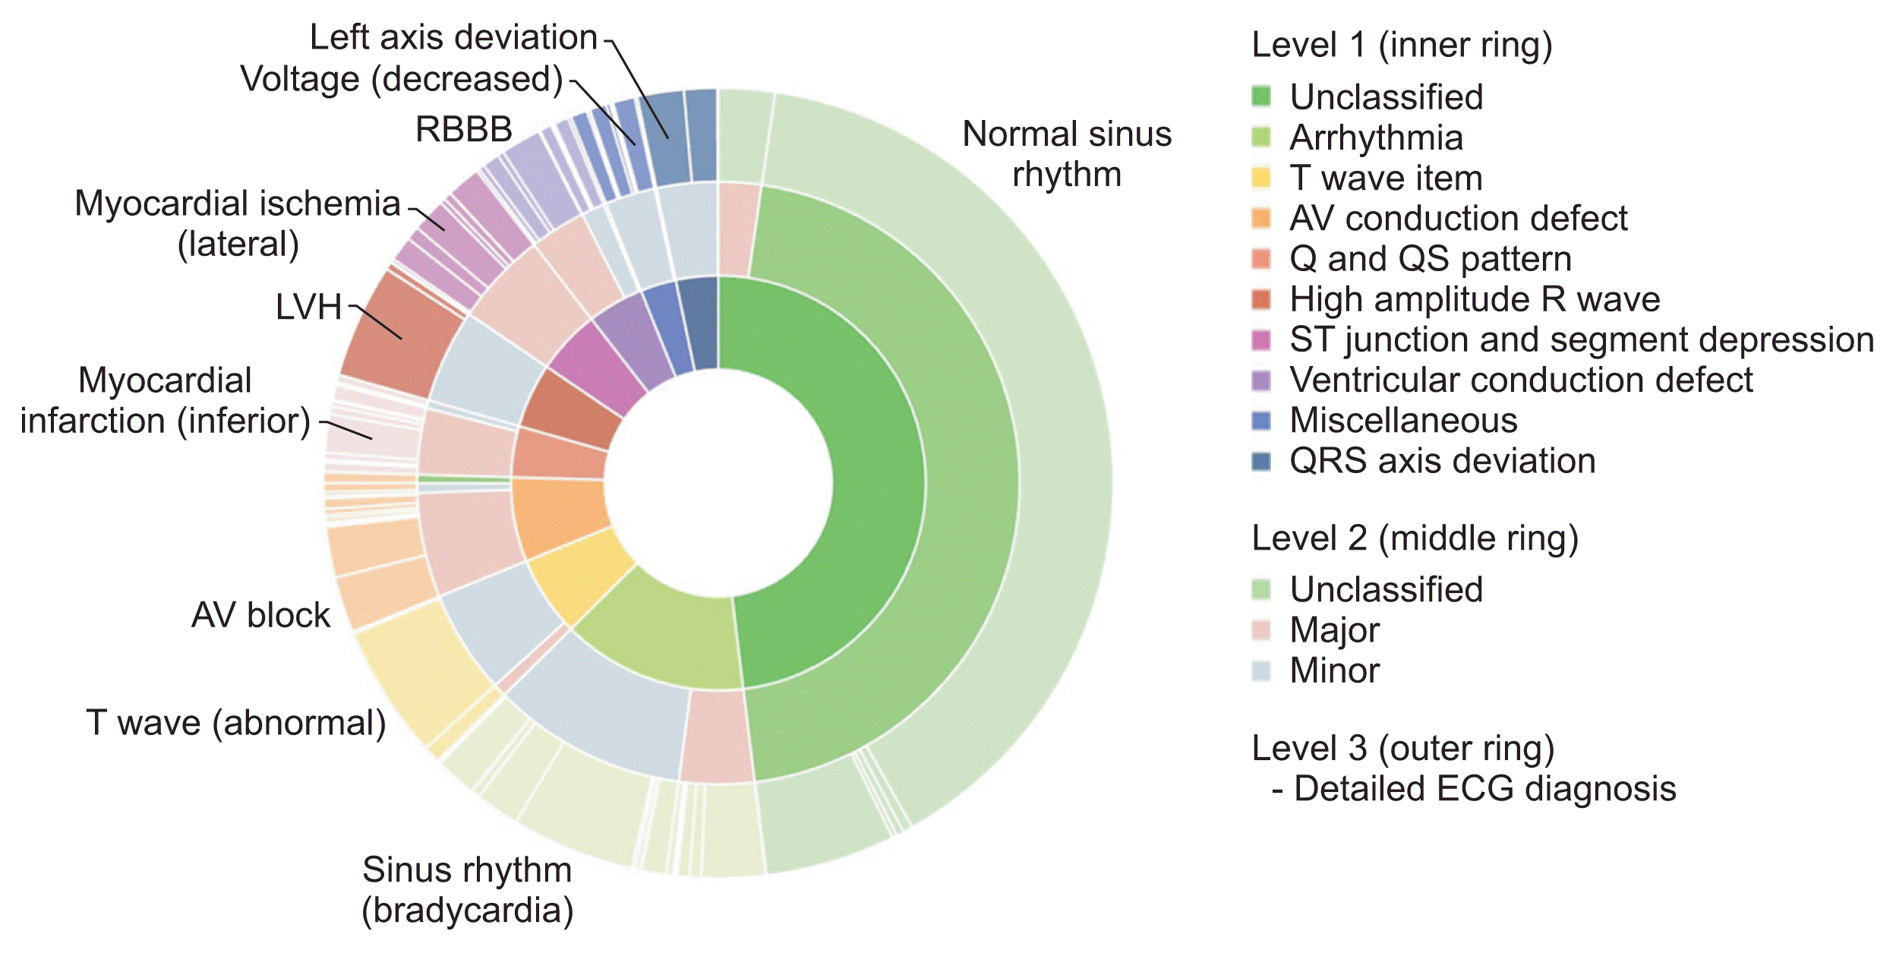
Data Preprocessing
Public datasets
43,100 ECG signals of varying length from 5 seconds to over 30 minutes
All data was sampled at 500 Hz on the same device model
All data was clinically validated by a physician
Data was stratified in terms of age, gender, and ethnicity.
Same # of healthy controls vs diseased
Data Preprocessing
Perez Alday EA, Gu A, J Shah A, Robichaux C, Ian Wong AK, Liu C, Liu F, Bahrami Rad A, Elola A, Seyedi S, Li Q, Sharma A, Clifford GD* Reyna MA*. Classification of 12-lead ECGs: The PhysioNet/Computing in Cardiology Challenge 2020. Physiol. Meas. 2021 Jan 1;41(12):124003. doi: 10.1088/1361-6579/abc960
Passthrough Filter
Powerline Filter
Standardization to [-1,1]
Resampling to 100 hz
Perez Alday EA, Gu A, J Shah A, Robichaux C, Ian Wong AK, Liu C, Liu F, Bahrami Rad A, Elola A, Seyedi S, Li Q, Sharma A, Clifford GD* Reyna MA*. Classification of 12-lead ECGs: The PhysioNet/Computing in Cardiology Challenge 2020. Physiol. Meas. 2021 Jan 1;41(12):124003. doi: 10.1088/1361-6579/abc960
Notes:
All training data was acquired from public datasets. Over 43,100 ECG signals were used with length varying from around 5 seconds to nearly 30 minutes. All data was sampled at 500 hz on the same device and was clinically validated by a physician. Our data was stratified equally in terms of age gender and ethnicity, and we had equal amounts of healthy controls and diseased individuals. Then we moved these data files through pre-processing. We first implemented a passthrough filter, which diminishes signals outside our defined physiological signal range of 2hz to 40 hz, we then implement powerline filter to eliminate any signals from fluorescent lights or other electronics. We then standardized our data in accordance with typical deep learning practice, in order to mitigate the effect of irregular maxima and minima. Finally, we implemented downsampling via FFT from 500hz to 100hz to reduce the computational data load.

Slide 11
Comprehensive Screening System
Sequential ECG for System Input
Data Preprocessing
Upscaling Algorithm
Transformer Encoding
Diseased
Transformer Encoding
Transformer Encoding
Classification via Support Vector Machine
Transformer Encoding
Transformer Encoding
Autoencoders for Dimensionality Reduction
Wildtype

Slide 12
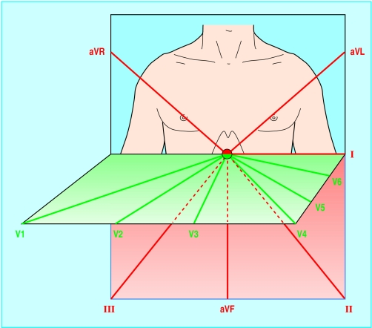
Why Upscaling?
Standard ECG utilizes 10 electrodes to derive 12 different leads
We hypothesize that it is possible to interpolate the full 12 leads from a reduced set of leads
Leads II, V1, V5, and AvF were selected, as they provide a diverse anatomical spectrum
A reduced data set of leads is beneficial to non-professionals to operate – easier placement
We can measure 4 leads using our system input cost-effectively, versus expensive ECG devices
Adapted from: Meek S, Morris F. ABC of clinical electrocardiography. Introduction. I-Leads, rate, rhythm, and cardiac axis. BMJ. 2002 Feb 16;324(7334):415-8. doi: 10.1136/bmj.324.7334.415. PMID: 11850377; PMCID: PMC1122339.
Notes:
So why do we need upscaling. Well a standard ECG takes 12 leads using 10 electrodes. These leads allow us to look at the heart from two different axis(Limb = vertical, horizontal = precordial.) We hypothesized that the interpolation of leads is possible due to many leads having close relations to each other that are well defined -> E.x Einthovon’s Triangle or Precordial Lead Progression. We selected Leads II, V1, V5, and AvF as they represent a diverse view of the heart from both the vertical and horizontal axis. This upscaling from 4 to 12 leads brings several benefits. 1. reduced set is better for mass screening as it makes it easier for a non-medical professional to operate because of easier placement, professionals already make mistkaes. In addition, using the apple watch reduces the cost substantially making the ECG test much more convenient.

Slide 13
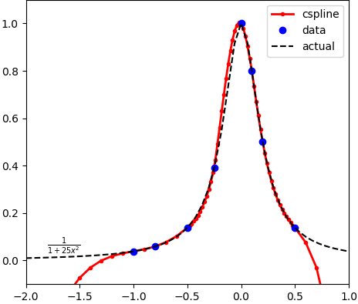
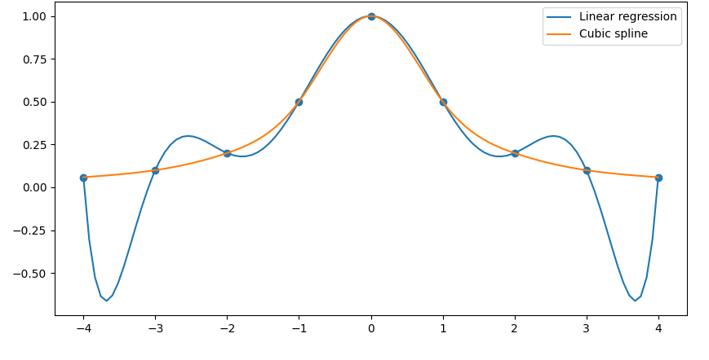

Upscaling Algorithm Pt 2
Cubic Spline Interpolation uses piecewise cubic functions to define a larger function
$$P\left(x\right)=ax^{3}+bx^{2}+cx+d$$
We reconstruct the function $\frac{1}{1+25x^{2}}$ using just 8 data points.
Reconstruction of a function is more accurate with cubic spline vs other methods
We iteratively update cubic polynomials to closely fit the sample points to reconstruct an unknown lead
We apply spatial correction to enhance accuracy: Einthoven’s Triangle and Precordial Lead Progression
Adapted from: https://apmonitor.com/wiki/index.php/Main/ObjectCspline
Adapted from: https://towardsdatascience.com/cubic-splines-the-ultimate-regression-model-bd51a9cf396d
Notes:
We utilized a method of interpolation called cubic spline interpolation where we essentially use a set of piecewsise cubic splines to interpolate a function. For example we can interpolate the function 1/1+25x^2 where the red line in the figure is the cspline and the black dotted line is the actual function, and you can see where data is present there is an extreme amount of accuracy. In addition looking at the figure below this, we can see that cubic spline is much better than the more common type of interpolation -> linear interpolation [bs here]. We iteratively updated cubic polynomials to closely fit sample points and reconstruct an unknown lead, essentially iterating over leads we can find defined cubic polynomials that fit our data the best. Followng this we implemented spatial interpolation, using known relations such as Einthoven and Precordial lead progression to refine our data.

Slide 14
Comprehensive Screening System
Sequential ECG for System Input
Data Preprocessing
Upscaling Algorithm
Transformer Encoding
Diseased
Transformer Encoding
Transformer Encoding
Classification via Support Vector Machine
Transformer Encoding
Transformer Encoding
Autoencoders for Dimensionality Reduction
Wildtype
Notes:
Moving onto classification.

Slide 15
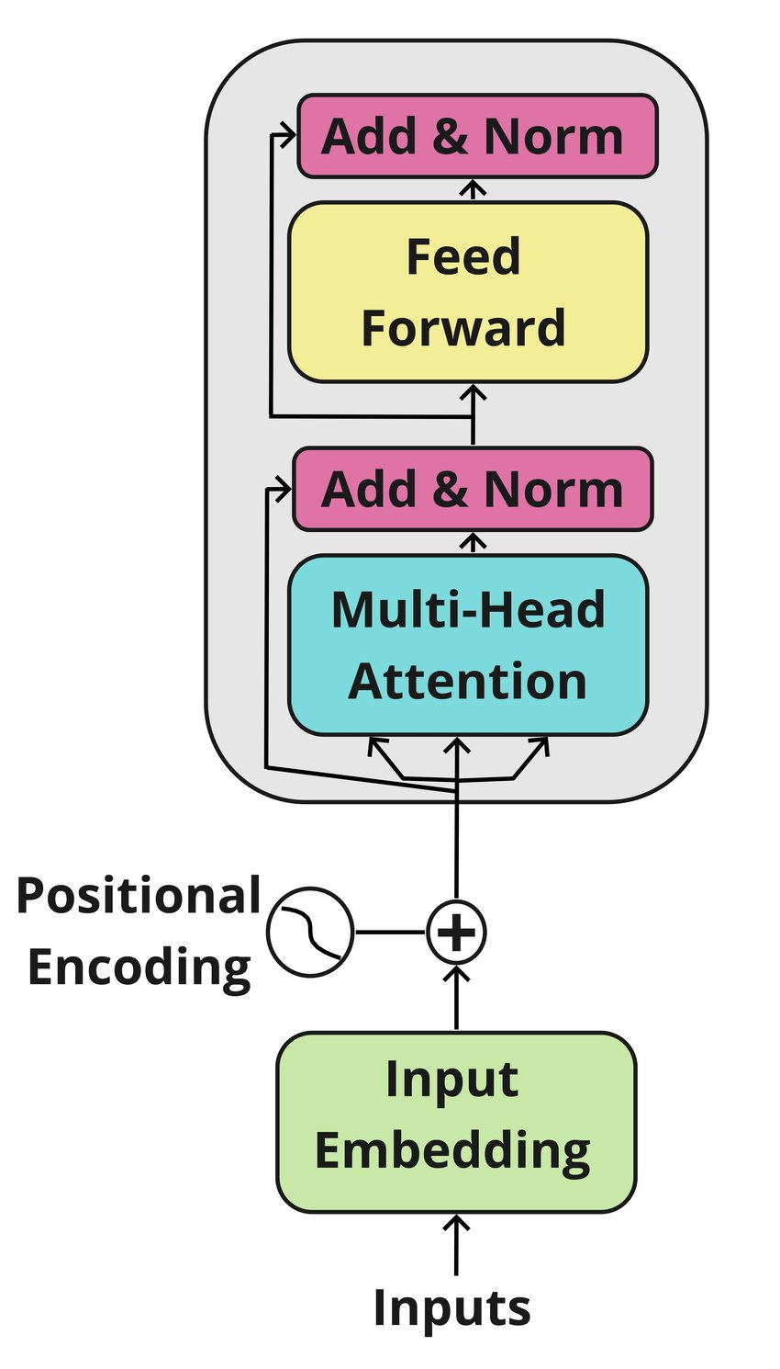
Classification Algorithm – Feature Extraction
All ECG signals were processed via upscaling algorithm and are segmented into 1 second files (255,000 files).
Step 1: Initial Feature Extraction
We first utilize the encoding portion of a Transformer to encode each ECG into a high-dimensional feature matrix -> associating pattern with diagnosis
Self Attention: Can extract complex temporal dependencies in the ECG data aka features
Hierarchical Encoder Extraction: Early layers extract basic features. Later layers extract complex features.
Essentially features based classification of ECG signals
Adapted from: https://www.researchgate.net/publication/352239001_Attended-over_Distributed_Specificity_for_Information_Extraction_in_Cybersecurity
Notes:
The Training data for our ECG classification algorithm used ECG signals processed thorugh our upscaling algorithm which were segmented into 1 second files, resulting in over 255,000 files. For Step 1: We used the encoding portion of a transformer network to extract features from the ECG. We encode these features into a high dimensional feature matrix associating certain patterns with a diagnosis. Transformer is ideal for classification via features, as it has self attention allowing the model to pay attention to several different parts of the ecg and allowing it to extract high level complex temporal dependencies in the ECG. In addition, hierarchical encoder extraction allows early encoder layers to extract easier features such as QRS complex and PR length, while layer layers extract complex features such as morphology or tiny variations and patterns in signal.

Slide 16
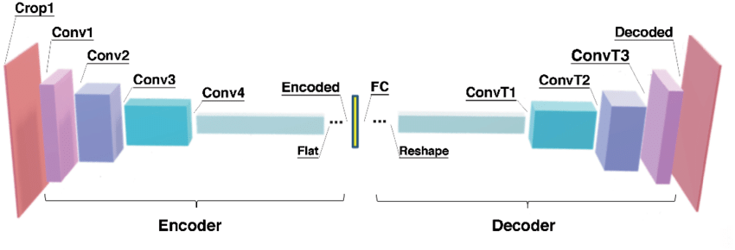
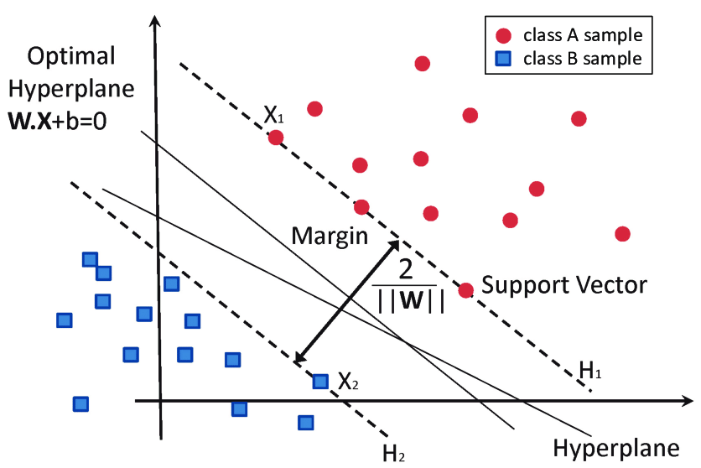
Classification Algorithm – CAE and SVM
Step 2: Dimensionality Reduction
We utilized 4 stacked Convolutional Auto-Encoders (CAEs) to reduce the dimensionality of our feature matrix
Each CAEs output feeds into the input of the next CAE
Reduced dimensionality = reduced computational load
Step 3: Feature Classification
The output of the stacked CAEs is then utilized as the input to a Support Vector Machine
SVM finds hyperplane with greatest margin
We utilized binary classification as our method of choice, essentially identifying someone as 1 (diseased) or 0 (non-diseased/clear for athletics)
Adapted from: https://www.researchgate.net/publication/347540445_Deep_Clustering_to_Identify_Sources_of_Urban_Seismic_Noise_in_Long_Beach_California
Adapted From: https://www.researchgate.net/publication/304611323_Hard-Rock_Stability_Analysis_for_Span_Design_in_Entry-Type_Excavations_with_Learning_Classifiers
Notes:
Step 2: Dimensionality Reduction
We need this because the outputted feature matrix from the transformer encoders have extremely high depth and dimensionality, making them hard to process for any algorithm. We use Convolutional Autoencoders stacked in order to process through these feature matrix’s extracting the important features while ignoring relatively frequent patterns. Each CAE feeds into the next CAE until a relatively low dimensional high accuracy feature matrix is generated. This is then the input into our classification algorithm or Step 3. We utilized support vector machines to classify via binary classification as 1(disease) or 0(non-disease), essentially finding hyperplanes with the greatest margin separating the two classes.

Slide 17
Results

Slide 18
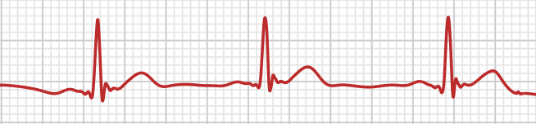
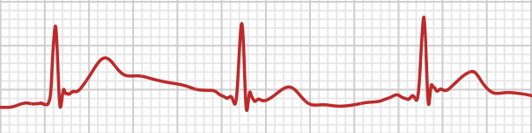
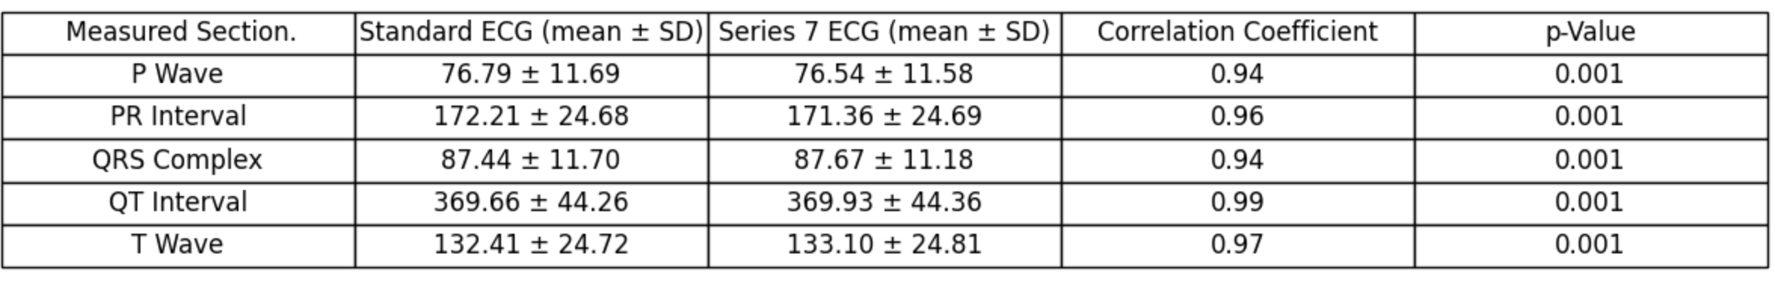
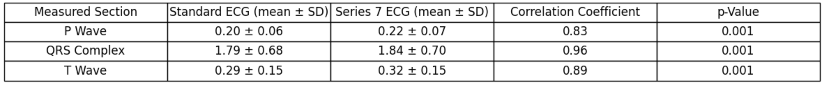
SW System Input Accuracy
Self Measured 4-Lead ECG Lead V6
We did not have much testing data for the SW System Input -> Tested on self
Shows viability as a method of screening with high correlation
Shows that Apple Watch S7 can record hi-fidelity ECG
Shows that our method of 4 lead acquisition via differential positioning is relatively accurate
Self Measured Apple Watch Lead V6
Duration in Milliseconds
Amplitude in Millivolts
Notes:
While we did not have a large testing cohort for our SW system input accuracy, I tested the device on myself in comparison to an actual 4 lead ECG. If we refer to the top two figures, figure 1 illustrates using a 4 lead ECG, while the second one illustrates a lead measured using our ECG method. You can also see in our data charts that the duration/amplitude are highly correlated between 4 lead ECG and our method of deriving ECG input. Average duration correlation of around 0.96, while average amplitude correlation of 0.90. This is without standardization of our apple watch screening method with no cleaning of sensors or anything. Our data shows that AW S7 can record hi-fidelity ECG. This showed that the 4 lead method via differential positioning of AW S7 is relatively accurate.

Slide 19
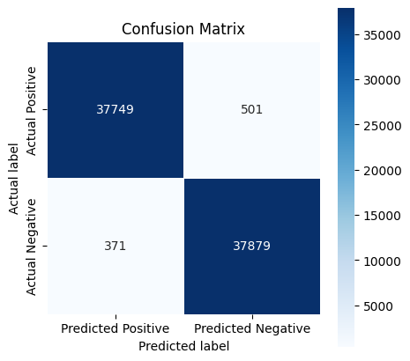
Classification Algorithm Accuracy
Sensitivity (Recall): 98.69%
Specificity: 99.03%
F1 Score: 98.86%
False Positive Rate (FPR): 0.97%

Slide 20
Conclusions
We demonstrate the development of a preliminary novel ECG screening protocol, costing sub 200 dollars per device, achieving economic viability.
2. Development of an accurate method of taking 4-lead non-emergent electrocardiogram via SW (Apple Watch S7) validated on a small cohort vs standard 12-lead Electrocardiography showing promising results.
3. Development of classification via Transformer and Convolutional Auto Encoders with sensitivity and specificity of 98.69% and 99.03% trained on upscaled ECGs.

Slide 21
Develop a desktop-based SQL based software package to store mass-screening results
Conduct testing on individuals with disorder (n=200)
Algorithmic Refinement for Apple Watch data
Feeds
into
Develop an app-based collection package with SW, evaluating ECGs on cloud

Slide 22
Acknowledgements and References

Slide 23
Acknowledgements
The author would like to thank:
Mr. Vivan Poddar – Shady Side Academy
Mr. Thomas Wang – Shady Side Academy
Dr. Wade Znosko – Shady Side Academy
"This research was supported in part by the University of Pittsburgh Center for Research Computing(CRC) through the resources provided. Specifically, this work used the H2P(Hail to Pitt) High Throughput Computing (HTC) cluster, which is supported by NSF award number OAC-2117681."

Slide 24
References
[1]: Okubo, M., Chan, H. K., Callaway, C. W., Mann, N. C., & Wang, H. E. (2020). Characteristics of paediatric out-of-hospital cardiac arrest in the United States. Resuscitation, 153, 227–233. https://doi.org/10.1016/j.resuscitation.2020.04.023
[2]: Tsao, C. W., Aday, A. W., Almarzooq, Z. I., Alonso, A., Beaton, A. Z., Bittencourt, M. S., Boehme, A. K., Buxton, A. E., Carson, A. P., Commodore-Mensah, Y., Elkind, M. S. V., Evenson, K. R., Eze-Nliam, C., Ferguson, J. F., Generoso, G., Ho, J. E., Kalani, R., Khan, S. S., Kissela, B. M., & Knutson, K. L. (2022). Heart Disease and Stroke Statistics—2022 Update: A Report From the American Heart Association. Circulation, 145(8). https://doi.org/10.1161/cir.0000000000001052
[3]: Maron, B. J., Thompson, P. D., Ackerman, M. J., Balady, G., Berger, S., Cohen, D., Dimeff, R., Douglas, P. S., Glover, D. W., Hutter, A. M., Krauss, M. D., Maron, M. S., Mitten, M. J., Roberts, W. O., & Puffer, J. C. (2007). Recommendations and Considerations Related to Preparticipation Screening for Cardiovascular Abnormalities in Competitive Athletes: 2007 Update. Circulation, 115(12), 1643–1655. https://doi.org/10.1161/circulationaha.107.181423
[4]: Angelini, P., Muthupillai, R., Cheong, B., & Paisley, R. (2020). We Have Plenty of Reasons to Propose New, Updated Policies for Preventing Sudden Cardiac Death in Young Athletes. Journal of the American Heart Association, 9(8). https://doi.org/10.1161/jaha.119.014368
[5]: Williams, E. A., Pelto, H. F., Toresdahl, B. G., Prutkin, J. M., Owens, D. S., Salerno, J. C., Harmon, K. G., & Drezner, J. A. (2019). Performance of the American Heart Association (AHA) 14‐Point Evaluation Versus Electrocardiography for the Cardiovascular Screening of High School Athletes: A Prospective Study. Journal of the American Heart Association, 8(14). https://doi.org/10.1161/jaha.119.012235
[6]: Maron, B. J., Shirani, J., Poliac, L. C., Mathenge, R., Roberts, W. C., & Mueller, F. O. (1996b). Sudden death in young competitive athletes. Clinical, demographic, and pathological profiles. JAMA, 276(3), 199–204. https://pubmed.ncbi.nlm.nih.gov/8667563/
[7]: Corrado, D., Basso, C., Pavei, A., Michieli, P., Schiavon, M., & Thiene, G. (2006). Trends in Sudden Cardiovascular Death in Young Competitive Athletes After Implementation of a Preparticipation Screening Program. JAMA, 296(13), 1593. https://doi.org/10.1001/jama.296.13.1593
[8]: Harmon, K. G., Zigman, M., & Drezner, J. A. (2015). The effectiveness of screening history, physical exam, and ECG to detect potentially lethal cardiac disorders in athletes: A systematic review/meta-analysis. Journal of Electrocardiology, 48(3), 329–338. https://doi.org/10.1016/j.jelectrocard.2015.02.001
[9]: Gupta, S., Baman, T., & Day, S. M. (2009). Cardiovascular Health, Part 1: Preparticipation Cardiovascular Screening. Sports Health: A Multidisciplinary Approach, 1(6), 500–507. https://doi.org/10.1177/1941738109350405
[10]: O’Connor, D. P., & Knoblauch, M. A. (2010). Electrocardiogram Testing During Athletic Preparticipation Physical Examinations. Journal of Athletic Training, 45(3), 265–272. https://doi.org/10.4085/1062-6050-45.3.265
[11]: Sharma, S., & Millar, L. (2015). Yes: Screening ECG Is Cost-Effective. American Family Physician, 92(5), 338–339. https://www.aafp.org/pubs/afp/issues/2015/0901/p338.html

Slide 25
Questions?

Slide 26

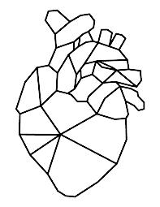

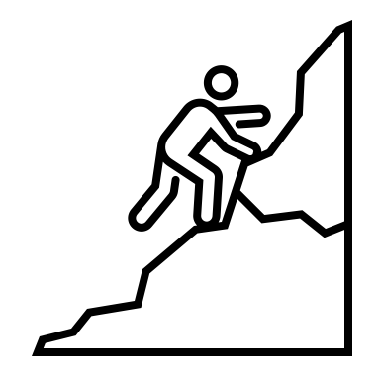
Research Problem
Engineering Target
Current methods of screening are inaccurate with low sensitivity.
False negative/positive rate is high, which is the opposite of the goal of mass-screening.
Potentially afflicted individuals may slip through cracks.
General Accuracy: Predict the presence of and type of pathology with sensitivity and specificity of 96% or greater on testing set.
System Input Device: Must reduce the cost of device by > 75%, and must have high signal accuracy and integrity
Classification Algorithm: Achieve an accuracy of at least % with at least 96% accuracy in binary classification
Current methods of screening are not clinically significant and have high false negative/positive rate.
Criteria & Specs
Climb to the Goal
Outputs: Patient afflicted(Y/N) and predicted pathology
Inputs: Accept a 4 lead ECG Waveform File(aECG HL7 FDA XML) measured from easy-to-use device
First Goal: Develop conversion algorithm for 4 to 12 lead ECG’s
Solution: Using Cubic Spline Interpolation.
Second Goal: Develop a fast and accurate classification algorithm to classify the primary pathologies behind Sudden Cardiac Arrest.
Solution: Transformer Network utilizing stacked convolutional autoencoders with Support Vector Machine binary classification
Accessibility: Device must be intuitive and easy to use, as well as generally accessible and cost-effective to implement.

Slide 27
Transformer: Outputs Attention Matrix
Stacked Convolutional Auto-Encoders
Classify via Support Vector Machine

